Slide 1
JOHN A. FERGUSON SENIOR HIGH
NO GOAL’S TOO HIGH WHERE FALCONS FLY!

Slide 2
Magnet & Choice Programs
John A. Ferguson offers both Magnet and Choice programs:
Magnet program applications are submitted through the District’s magnet application system. If students are eligible, selection for the programs are based on random lottery.
Choice programs are completed through a District transfer. Initial application is on the Ferguson website. If a student is eligible and the transfer is approved, the student is placed in the program.

Slide 3
FERGUSON CHOICE PROGRAMS

Slide 4
DESIGN & ARTS ACADEMY CHOICE PROGRAMS:
ARCHITECTURE/INTERIOR DESIGN
CHORUS
DANCE
FILM
FINE ARTS & DESIGN
MUSIC
PHOTOGRAPHY
TV PRODUCTION
THEATER

Slide 5
BUSINESS ACADEMY CHOICE PROGRAM:
TEACHING & LEARNING

Slide 6
FERGUSON MAGNET PROGRAMS

Slide 7
MEDICAL SKILLS/BIOMEDICAL ACADEMY MAGNET PROGRAMS:
BIOTECHNOLOGY
EMERGENCY MEDICAL RESPONDER
NURSING ASSISTING
SPORTS MEDICINE
VETERINARY ASSISTING
ALL PROGRAMS REQUIRE COMPLETION OF ALGEBRA 1 PRIOR TO BEGINNING 9TH GRADE

Slide 8
BUSINESS ACADEMY MAGNET PROGRAMS:
ACCOUNTING APPLICATIONS
BUSINESS MANAGEMENT
INTERNATIONAL BUSINESS
EARLY CHILDHOOD EDUCATION
CULINARY ARTS (THIS HAS ITS OWN APPLICATION SELECTION)

Slide 9
INTERNATIONAL BACCALAUREATE MAGNET PROGRAM:
ADVANCED ACADEMICS, COLLEGE PREPARATORY PROGRAM
STUDENTS HAVE THE OPPORTUNITY TO EARN AN INTERNATIONALLY RECOGNIZED DIPLOMA AND CREDITS TOWARDS COLLEGE
EARNING AN IB DIPLOMA AUTOMATICALLY QUALIFIES A STUDENT FOR THE FLORIDA ACADEMIC SCHOLARS BRIGHT FUTURES SCHOLARSHIP
REQUIRES COMPLETION OF ALGEBRA 1 PRIOR TO BEGINNING 9TH GRADE & COMPLETION OF GEOMETRY & BIOLOGY PRIOR TO ENTERING 10TH GRADE

Slide 10
iTech (INFORMATION TECHNOLOGY) MAGNET PROGRAMS:
DIGITAL DESIGN
GAME/SIMULATION/ANIMATION DESIGN
ROBOTICS
TECHNOLOGY SUPPORT SERVICES
VIRTUAL REALITY

Slide 11
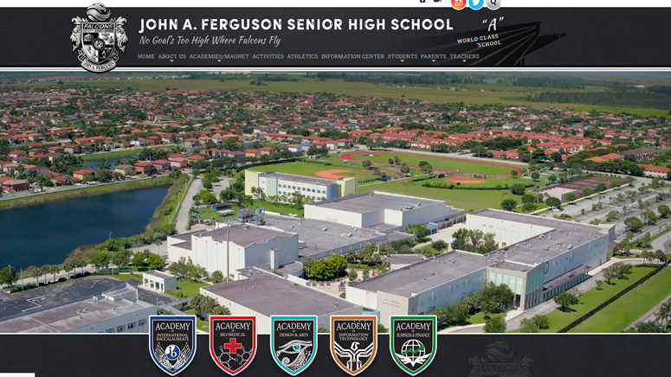
For more information please visit our website:
www.fergusonhs.org

